Slide 1
Variance Analysis
Submitted by:
Namratha Beeru
Dimple Gowda Sadarhalli Kantha Raju
Vu Mai
Sundaram.M.R
Jayrajsinh Sisodiya
Hari Hara Sudhan Venkateswaran

Slide 2
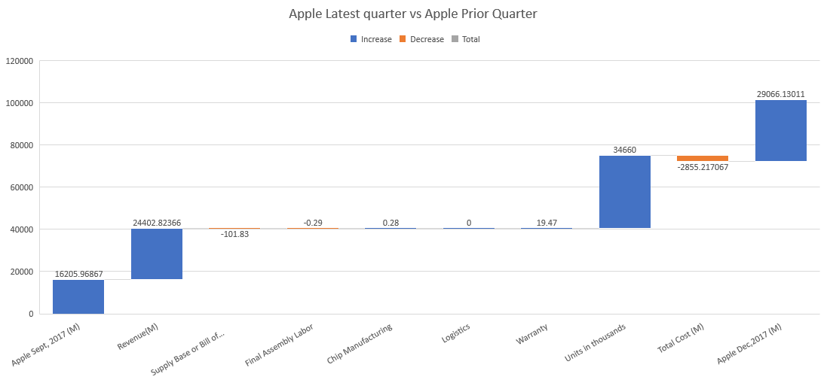

Apple’s Revenue has been increased by 35 % in last 3 months because of their increase in numbers of units sold and reduction in warranty cost per unit.

Slide 3
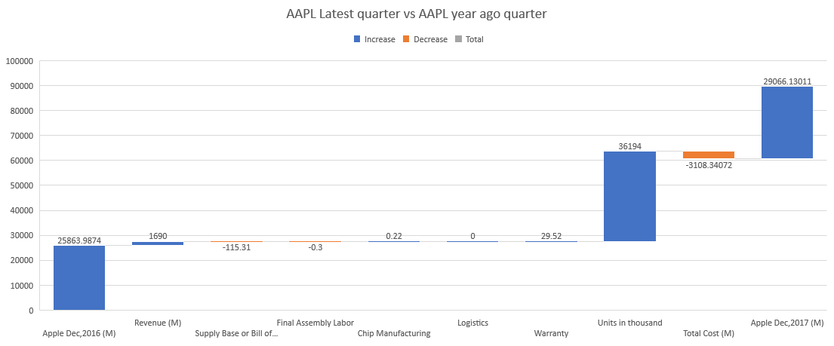
In 2017, Apple’s gross profit has only increased by 2.5 % compared to last year due to increase in manufacturing cost per unit.

Slide 4
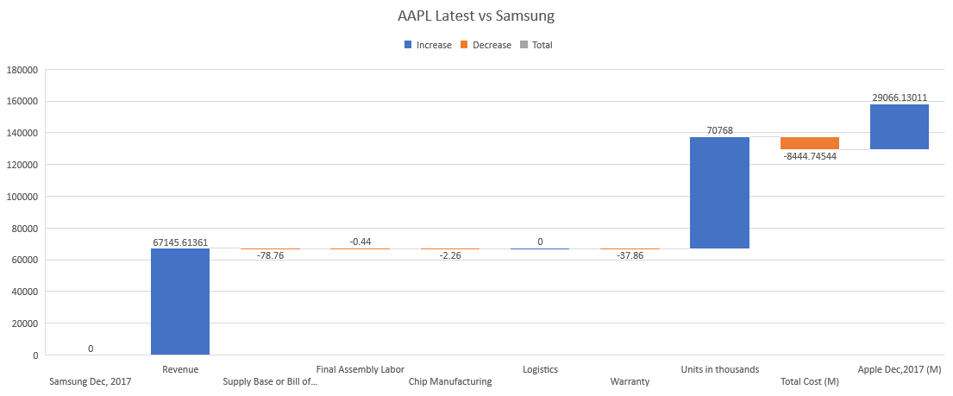
Apple has a significant advantage in gross profit because apple’s number of sold unit is 3.8 times higher than Samsung’s number of sold unit.

Slide 5
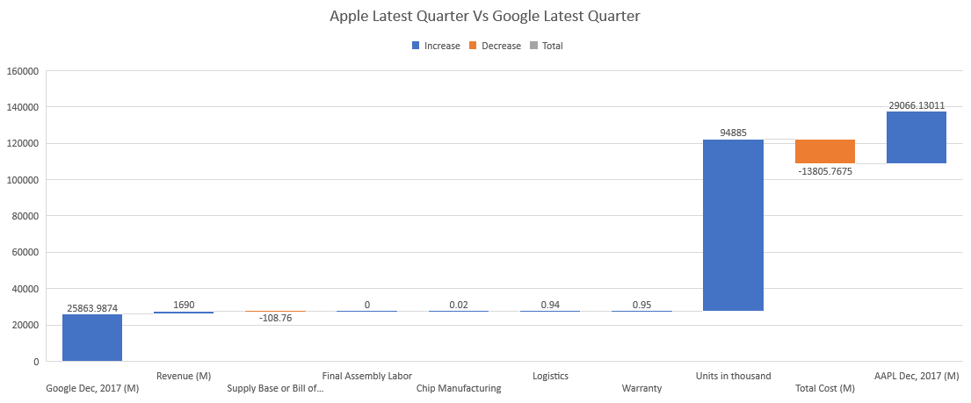
Apple’s revenue generated by selling iPhone is significantly higher because Google's number of mobile sold is only 1 % of Apple’s number of iPhone sold in 2017.

Slide 6
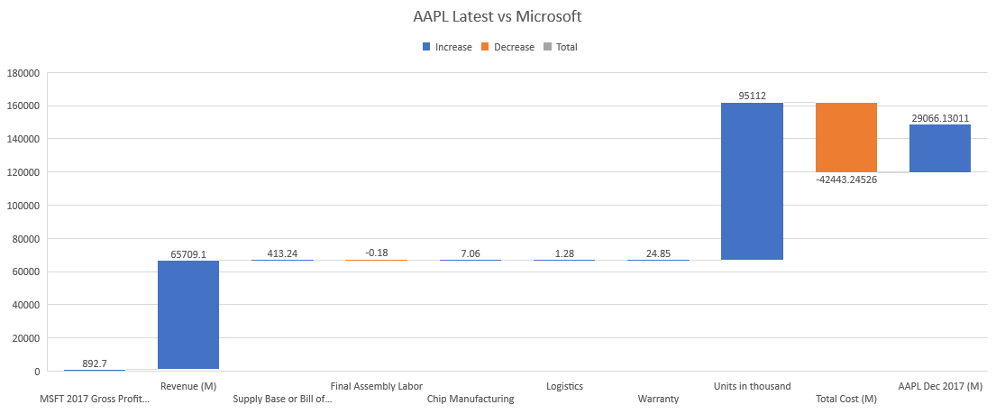
Apple has a significant advantage against Microsoft due to Microsoft’s high manufacturing cost and high bill of materials.

Slide 7
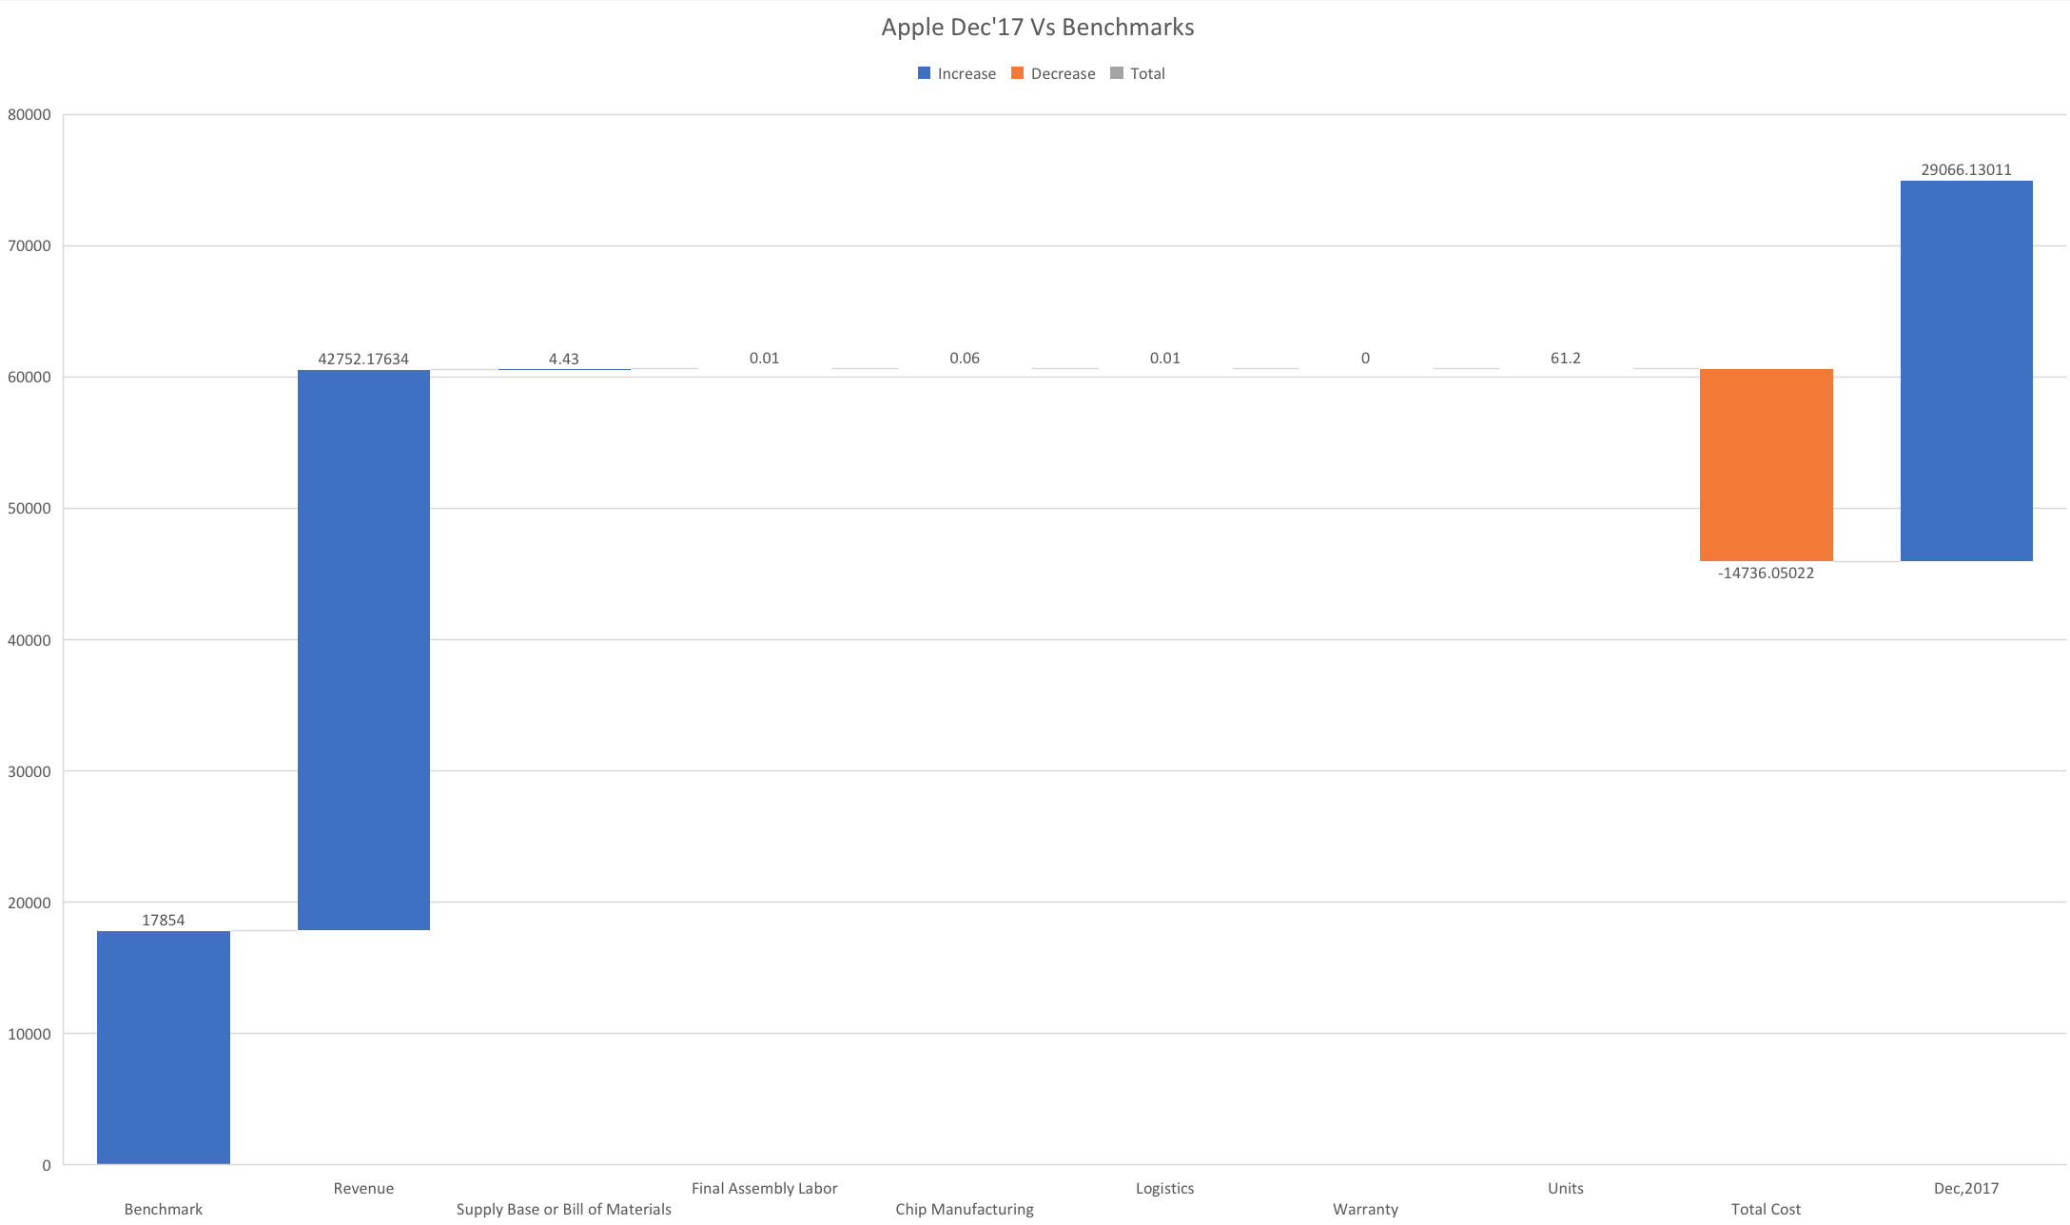
Apple’s revenue significantly increased due to the introduction of new iPhone model

Slide 8
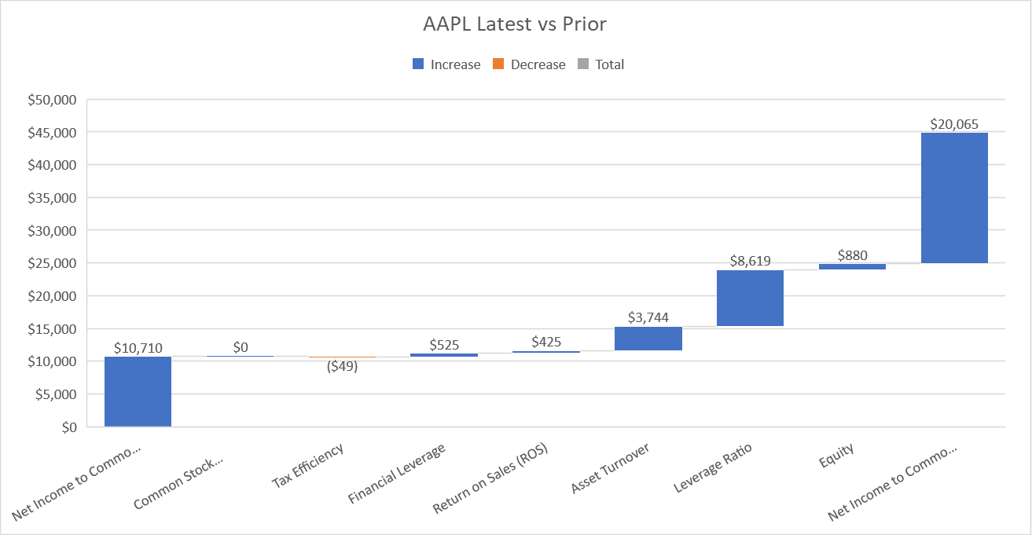
Apple has a significant advantage due to high leverage ratio in last quarter of 2017.

Slide 9
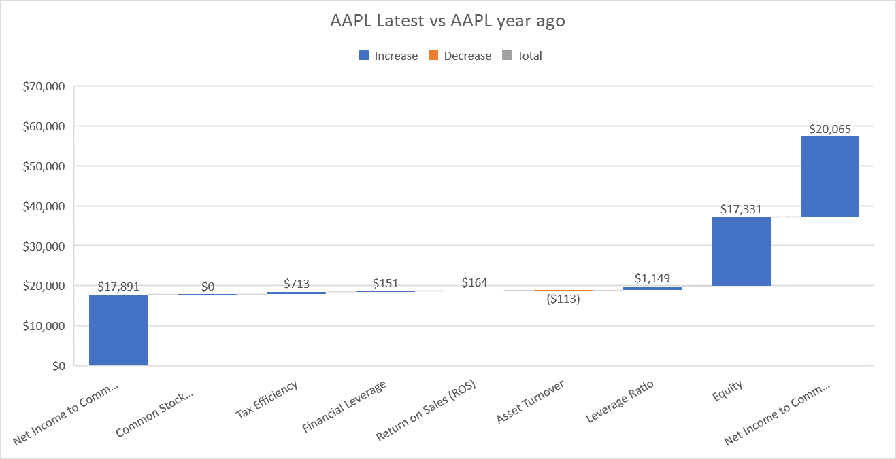
Apple’s net income to common stock has only increased by 12 % in a year due to increase in tax efficiency.

Slide 10
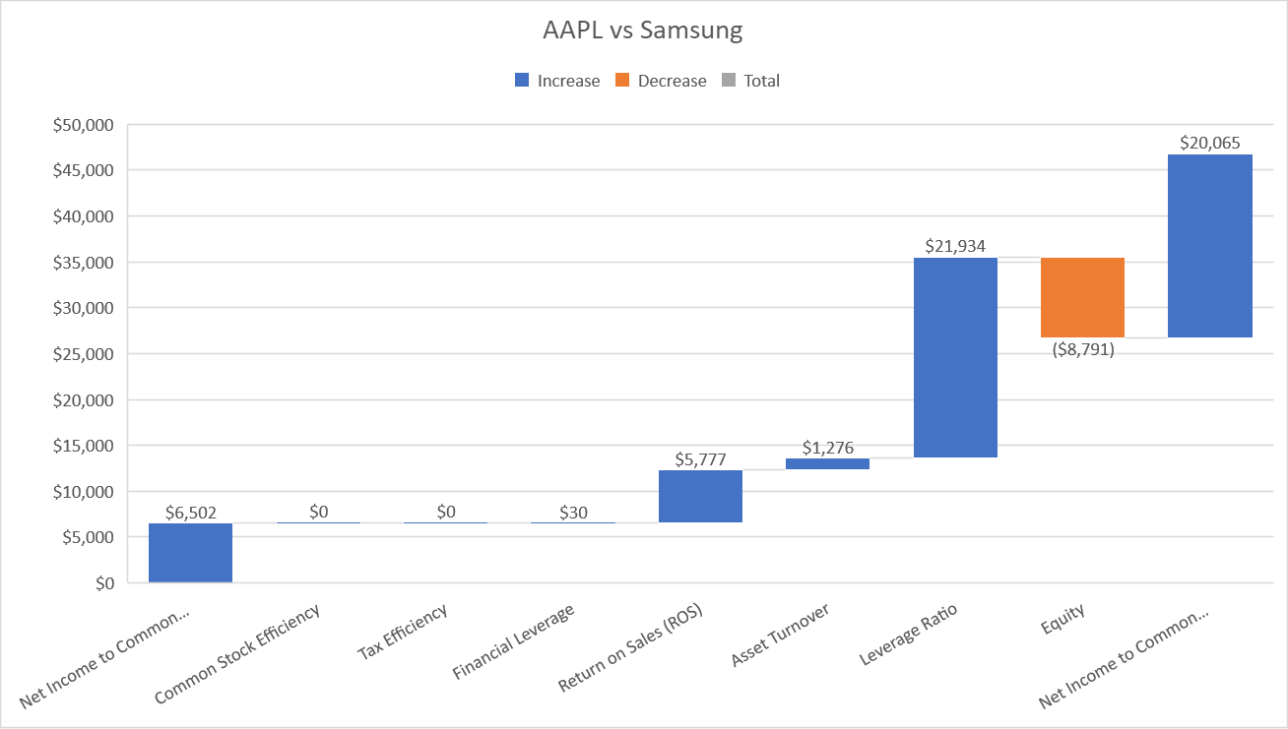
Apple has a significant advantage over Samsung due to 4 times higher leverage ratio and high return on sales.

Slide 11
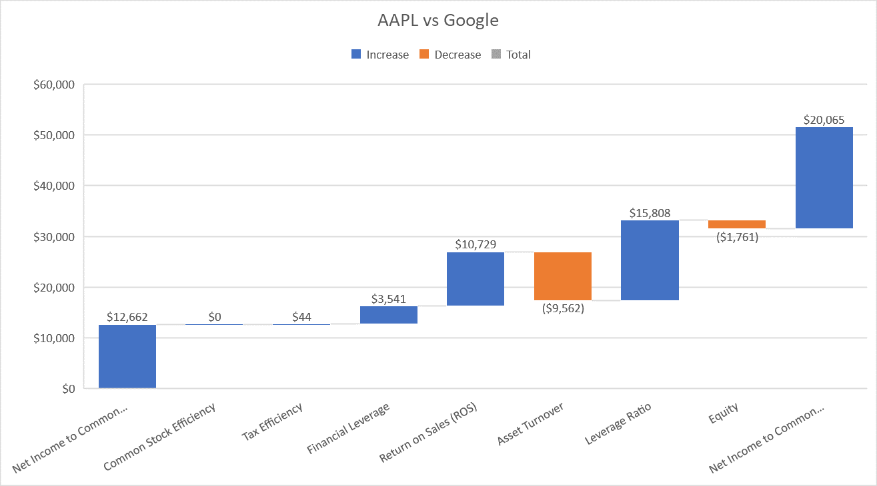
Apple’s high return on sales and high leverage ratio become significant factors to outperform Google.

Slide 12
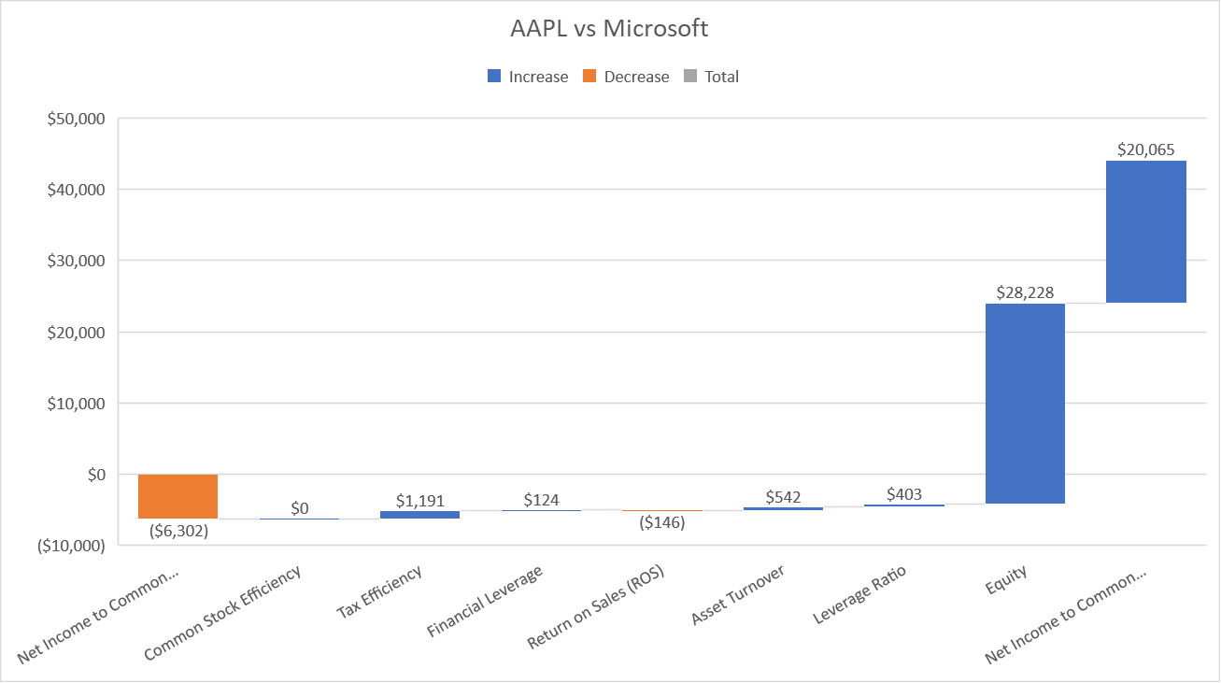
Microsoft’s falling tax efficiency and falling profit margin gives Apple an advantage in net income available to common stock.

Slide 13
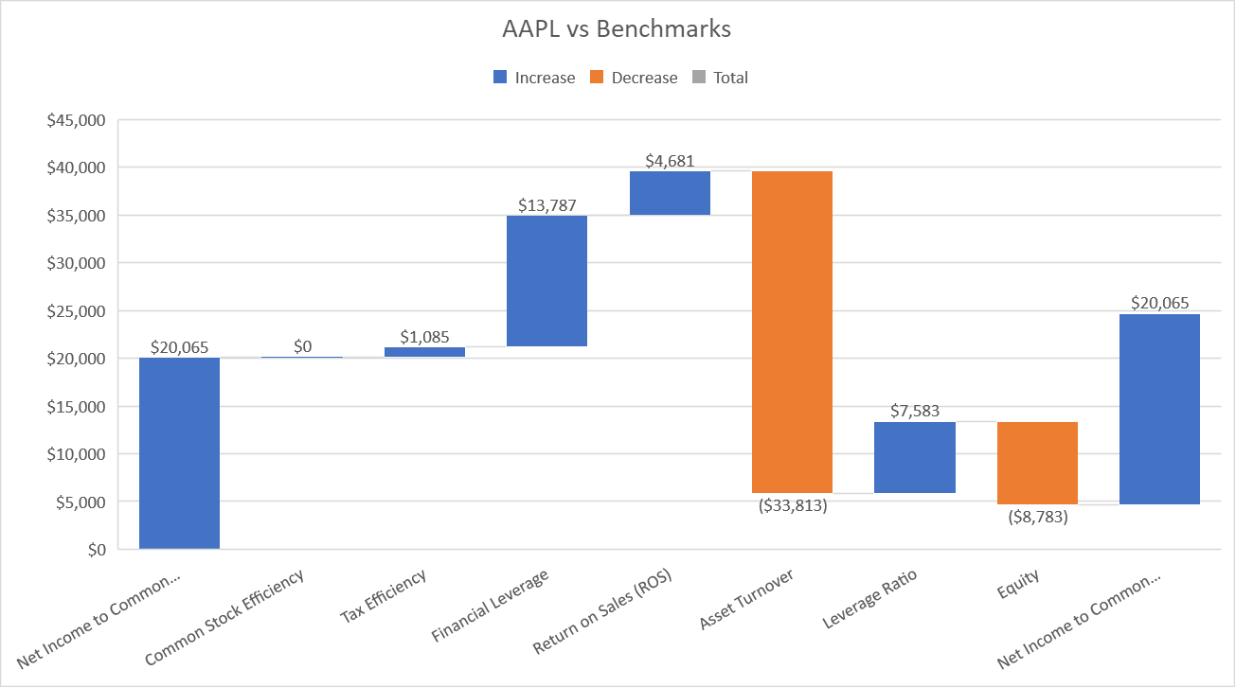
Apple’s low asset turnover becomes a deciding factor in their decreasing equity.

Slide 14
Areas For Improvement
Areas of Improvement | Net Income $
Supply Base or Bill of Materials (Google) | 278
Total Manufacturing (Samsung) | 1.54
Final Assembly Labor (Samsung) | 0.85
Logistics (apple and Samsung) | 0.72
Chip Manufacturing (Samsung) | 0.68
Warranty (Microsoft) | 0.08

